Slide 1

Smart neighborhood system for shutters management
Baraldi Francesco, Pagliani Matteo

Slide 2
Outline
Introduction
Architecture
Prototype specifications
Reinforcement learning approach
Video Demo

Slide 3
Introduction

Slide 4
Introduction
Too lazy to close the shutters in case of a thunderstorm?
Do you often forget to close the shutters before falling asleep?
Or do your flowers need sunlight when you are on holiday away from home?
→ This system is the answer for you! Our product automatically open or close the shutters of houses depending on weather conditions. Its scalability allows it to be used not only by you, but also by your neighbours, aiming to control the shutters of several houses in your neighbourhood simultaneously.

Slide 5
How to use
You don’t have to worry about anything, the system takes care of your house for you:
When specific weather conditions trigger our system, it will take a decision about closing or opening the shutters in total autonomy. You will be notified directly on your smartphone when a decision is taken, and you can feed back if you liked that decision or not, giving us the possibility to improve based on your habits! The system learns how to perfectly fit your needs
When you are away, you can always control the shutters remotely via web
Obviously, you can control the shutters manually thanks to specific buttons installed in your house
The system takes into account your neighbours action to make better decisions on your own windows

Slide 6
Composition of the kit
The kit is composed by:
1 internal kit per house: a microcontroller, an actuator and a button for each of the windows you want to control
1 external kit per neighbourhood: some sensors (a photoresistor and a wind speed sensor) and a control unit for the whole neighbourhood, which will be installed in a strategic position close to the houses to be managed
Finally you shall install the Telegram application on your smartphone and keep on hand the web site for optimal control.

Slide 7
Key points: why chosing our system?
Because it is:
Easy to setup
Not invasive
Automatic
Flexible
Scalable
Adaptive to users’ habits

Slide 8
Architecture

Slide 9
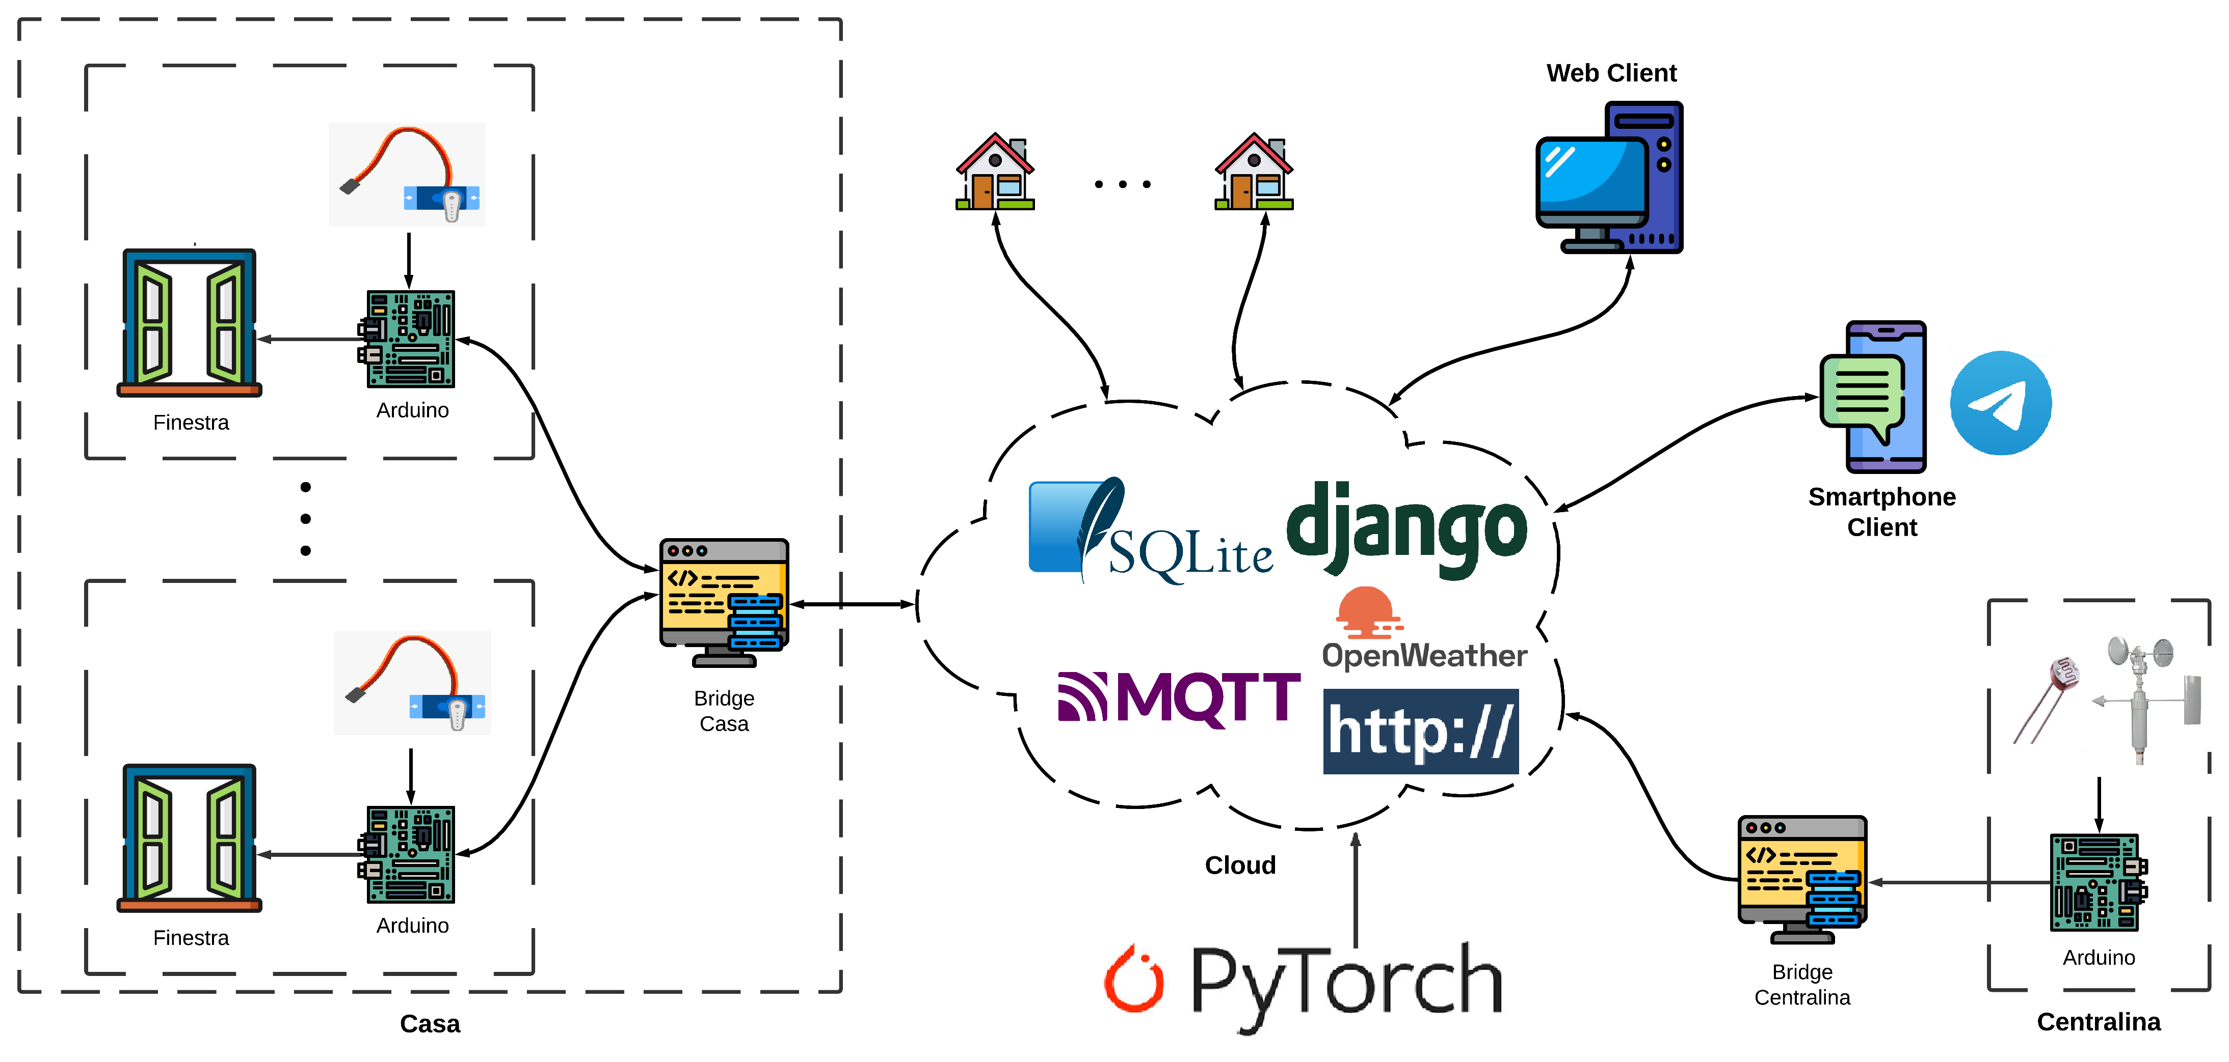
Architecture: real model

Slide 10
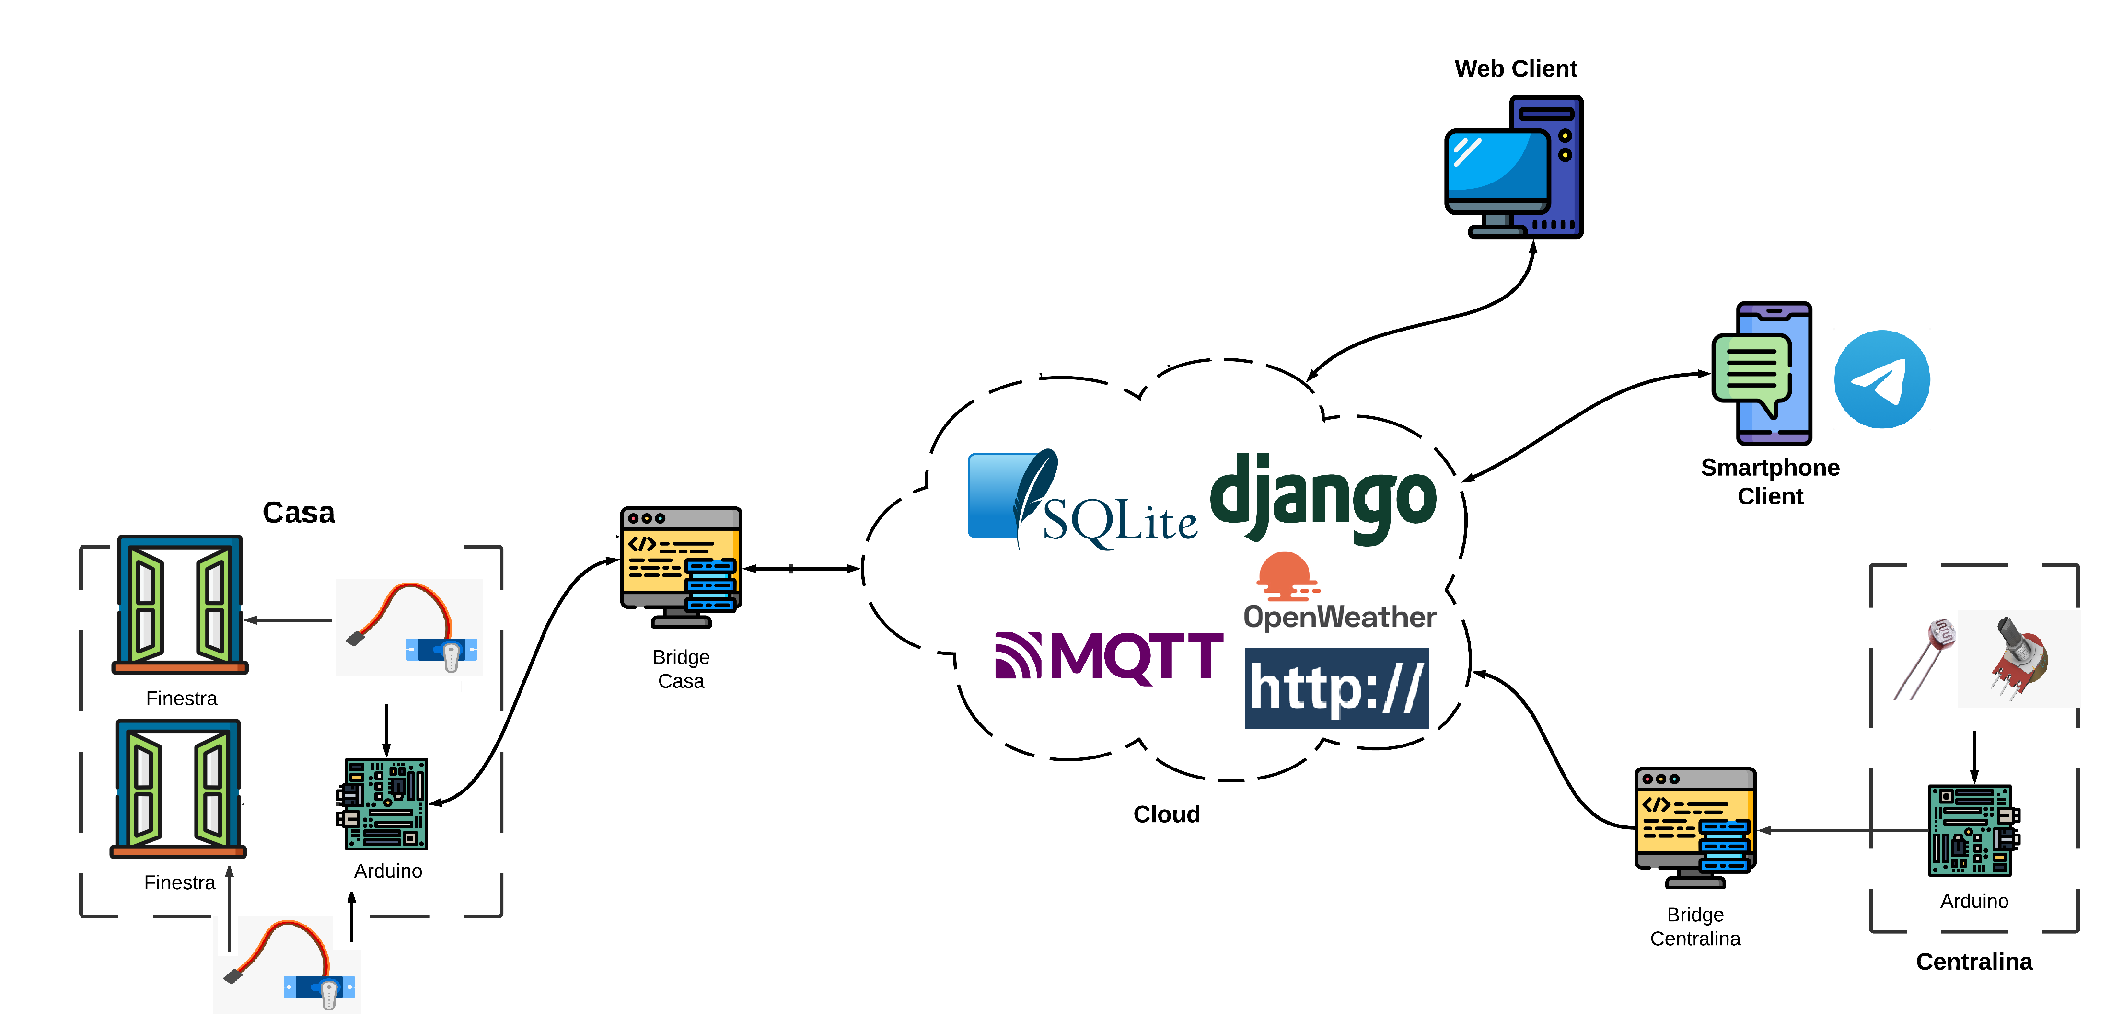
Architecture: prototype

Slide 11
Prototype specifications

Slide 12
Real model vs prototype
Real Model | Prototype
1 Arduino Nano for each window | 1 Arduino UNO Rev.3 for two windows
1 Raspberry Pi for each house which manages all the house’s windows and runs the internal bridge | Laptop as internal bridge
1 Raspberry Pi for each neighborhood that runs the external bridge | Laptop as external birdge
Server Django and engine hosted with a public IP | Server Django and engine running in localhost
Prettier buttons | Push buttons
1 custom actuator for each window | 1 servomotor for each window (Hitec and TowerPro)
Wind speed sensor | 1 potentiometer as wind speed sensor
Proper web app frontend for improved UE | Simple web app using Django template
Deep Reinforcement Learning decision logic to manage all possible combinations of states | Hard-coded decision logic and neighbours “control” in case of uncertain situations

Slide 13
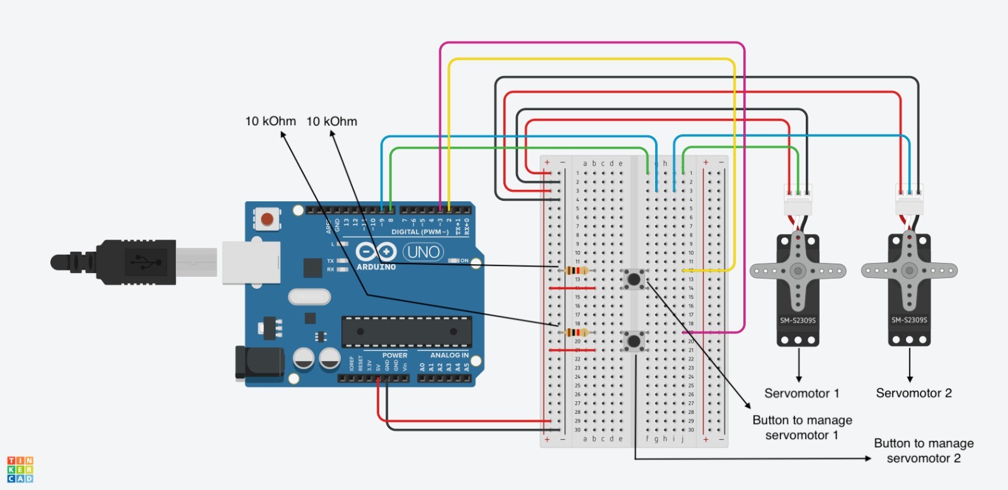
Connection schemas
The Arduino Uno for the internal kit is connected to:
1 Hitec servomotor
1 TowerPro servomotor
2 push buttons

Slide 14
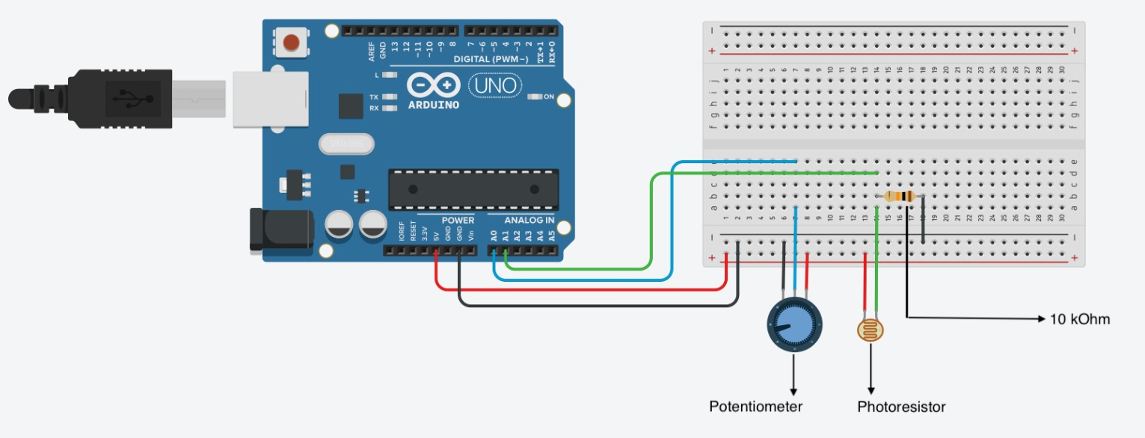
Connection schemas (1)
The Arduino Uno for the external kit is connected to:
1 photoresistor
1 potentiometer

Slide 15
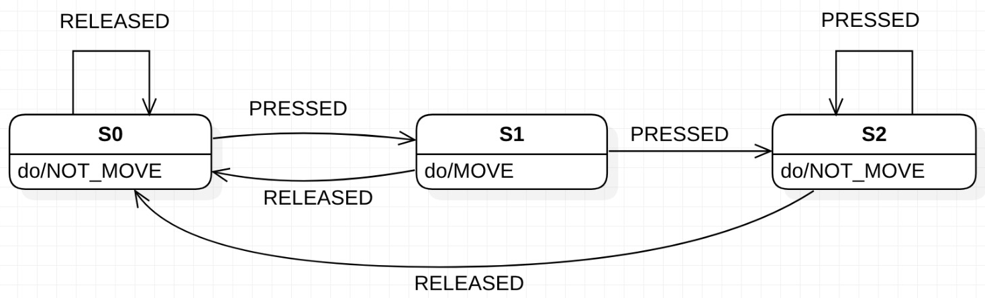
FSM for push buttons
States: {S0, S1, S2}
S0: initial state
S1: button pressed
S2: button pressed more than one time consecutively
Inputs: {PRESSED, RELEASED}
PRESSED : high (5V) digital signal due to the button pression
RELEASED : low (0V) digital signal due to the button release
Outputs: {MOVE, NOT_MOVE}
MOVE: allows the servo to change the state of the window (from open to closed or viceversa)
NOT_MOVE: does not allow the servo to change the state of the window

Slide 16
Code tables for serial communication between «internal» Arduino and its bridge
0xFF | 0x01 | WINDOW_PIN | 0xFE
Header | Payload length | Payload | Footer
Header (1 byte): identifies the beginning of the packet
Payload length (1 byte): specifies the byte length of the payload
Payload (1 byte): the microcontroller writes on the serial bus the number of the pin connected to the servomotor whose window has just changed state. The bridge will read from the serial and will update accordingly in the database the state of the window.
Footer (1 byte): identifies the end of the packet

Slide 17
Code tables for serial communication between «external» Arduino and its bridge
0xFF | 0x02 | Potentiometer value | Photoresistor value | 0xFE
Header | Payload length | Payload | Payload | Footer
Header (1 byte): identifies the beginning of the packet
Payload length (1 bytes): specifies the byte length of the payload
Payload (2 byte): the first and the second byte are respectively the value read by the potentiometer and the value read by the photoresistor, both mapped from the original range 0 – 1024, to the range 0 – 253 in order to store them in exactly one byte
Footer (1 byte): identifies the end of the packet

Slide 18
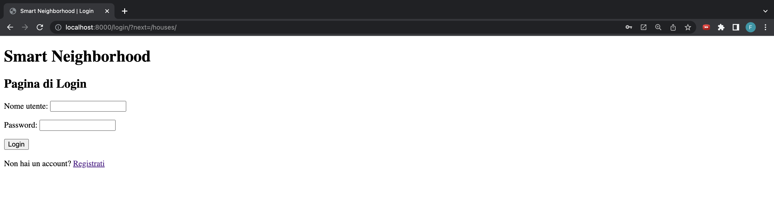
Web App – Login Page

Slide 19
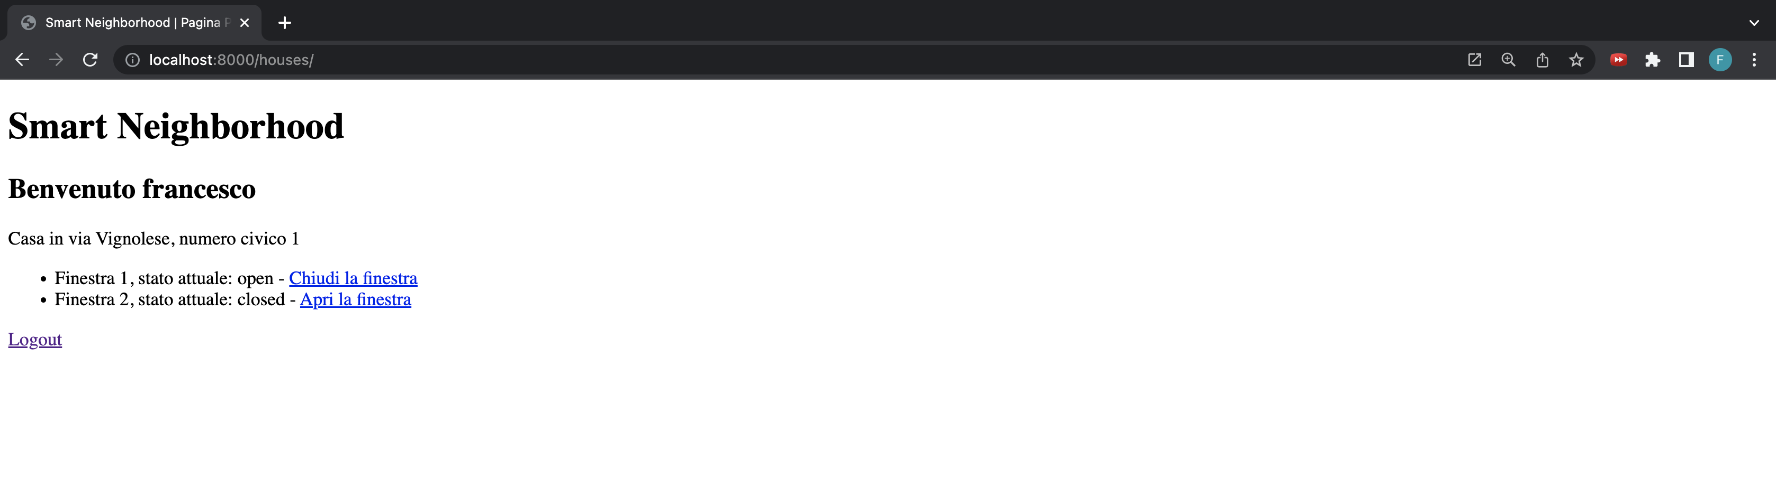
Web App – Home Page

Slide 20
Telegram bot
A Telegram bot called smart_neighborhood is used to notify the house’s owners whenever the system decides to move the windows. The bot has two simple commands:
/start, that is automatically called when the bot is started, gives a welcome message and store, if new, the user in the database;
/help, which gives a short description of bot’s functionalities.
When the engine decides to move the windows, it calls a specific function of the bot which sends a message to all the chat IDs stored in the database in order to make the owners aware of the new state of their windows. In the message, it is also suggested to use the web app to change the state of the windows if the new state does not match the user’s will.

Slide 21
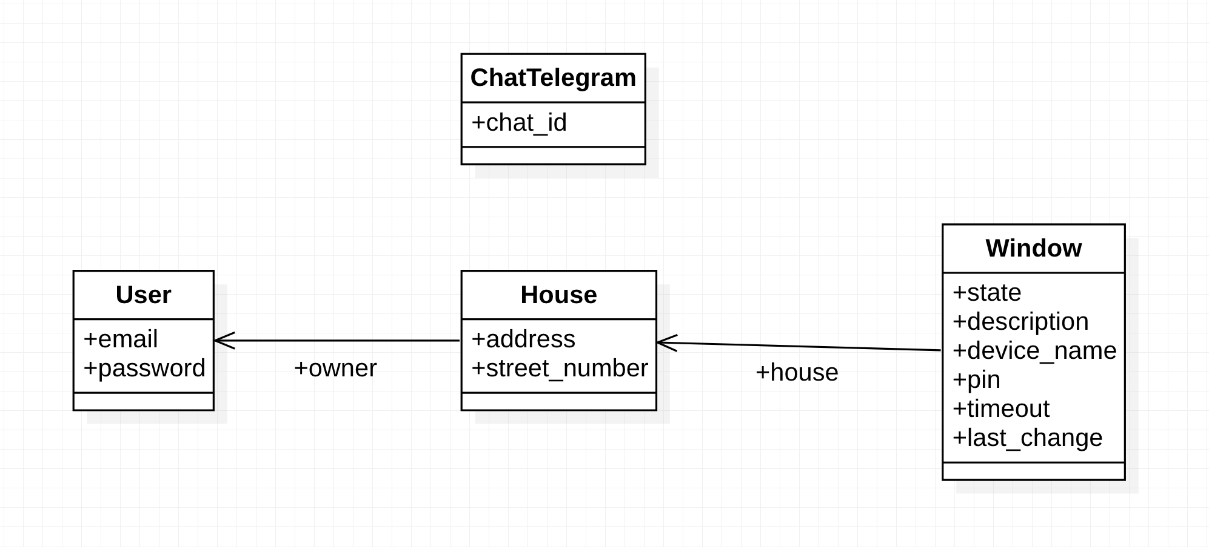
SqLite3 database structure

Slide 22
SqLite3 database structure (1)
The database is automatically managed by Django using the model part of the MVC approach: we define a python class for each DB table and Django creates the respective relational DB. The 4 classes are described below:
ChatTelegram: it represents a Telegram chat identified by the chat_id;
User: it represents a user and is managed automatically by Django authentication system. It has a unique email and a password;
House: it models an house where the system is installed. It’s described by the address and the street number and it is associated with a User object which represents the owner of the house;
Window: it is a generic window object, each one is associated with a house and has a current state (closed or open), a text description, a device name (identifier for the Arduino that manages this specific window) and a pin (the pin number connected to the actuator in the Arduino board), a timeout (a boolean field which says if the window can be moved autonomously by the system or not) and finally a date which represents the last_change timestamp.

Slide 23
OpenWeather APIs
The data retrieved from the OpenWeather APIs are the current temperature and weather condition: the latter is categorized with different codes, each of them assigned to a close/open/ambiguous condition in order to process the information and take the correct decision. These are the categories:
Group 2xx: thunderstorm, we consider it as a close condition;
Group 3xx: drizzle, we consider it as an ambiguous condition;
Group 5xx: rain, we consider it as a close condition;
Group 6xx: snow, we consider it as a close condition;
Group 7xx: atmosphere, we consider it as an open condition;
Value 800: clear, we consider it as an open condition;
Group 80x: clouds, we consider it as an ambiguous condition.

Slide 24
Decision logic
The system decides to open or close the windows depending on the 4 parameters values: temperature, wind, lightness and weather condition. For each of them there are three ranges of possible values: one for the close condition, one for the open condition, and one for an ambiguous condition. The decision is taken as follows:
If at least 2 values belong to the open condition range, then open the windows;
If at least 3 values belong to the close condition range, then close the windows;
If none of the previous, then there is an ambiguous condition and a “neighbourhood control system” is used in order to take the best decision.

Slide 25
Neighbourhood control
In case of uncertain situations, for example …, we look at neighbours decisions.

Slide 26
Reinforcement learning approach

Slide 27
Vanilla Q-Learning
The “vanilla” Q-Learning uses a Q-table that maps a state-action pair to a Q-value (the maximum expected future reward) which the agent will learn. As the agent tries out different actions at different states through trial and error (exploration), the agent learns each state-action pair’s expected reward and updates the Q-table with the new Q-value. After an agent has learned the Q-value of each state-action pair, the agent at state S has to choose an action A (exploitation). The most common approaches are:
Greedy strategy: maximizes the expected reward by choosing the action A with the highest Q-value
Epsilon greedy strategy: at every time step chooses a random action with probability epsilon and the best known action at the agent’s current state with probability 1 – epsilon. Epsilon is initialized to 1, meaning every step is random at the start. As the agent takes more and more steps, the value of epsilon decreases and the agent starts to try existing known good actions.

Slide 28
Vanilla Q-Learning (1)
The Bellman Equation tells us how to update our Q-table after each step we take. The agent updates the current Q-value with the estimated optimal future reward which assumes that the agent takes the best current known action.
S = the State or Observation
A = the Action the agent takes
R = the Reward from taking an Action
t = the time step
⍺ = the Learning Rate
ƛ = the discount factor which causes rewards to lose their value over time so more immediate rewards are valued more highly

Slide 29
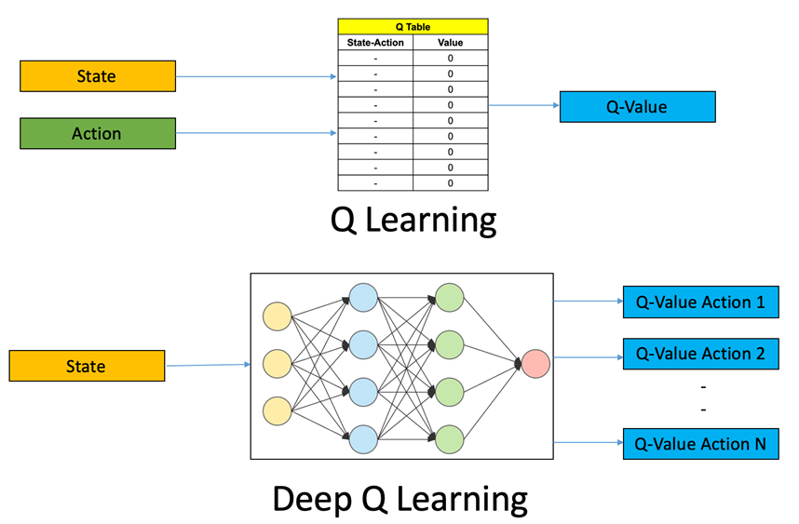
DQN
DQN (Deep Q-Learning Networks) is a model-free reinforcement learning algorithm in which a neural network maps input states to (action, Q-value) pairs.
Initialize your Main and Target neural networks
Choose an action using the Epsilon-Greedy Exploration Strategy
Update your network weights using the Bellman Equation

Slide 30
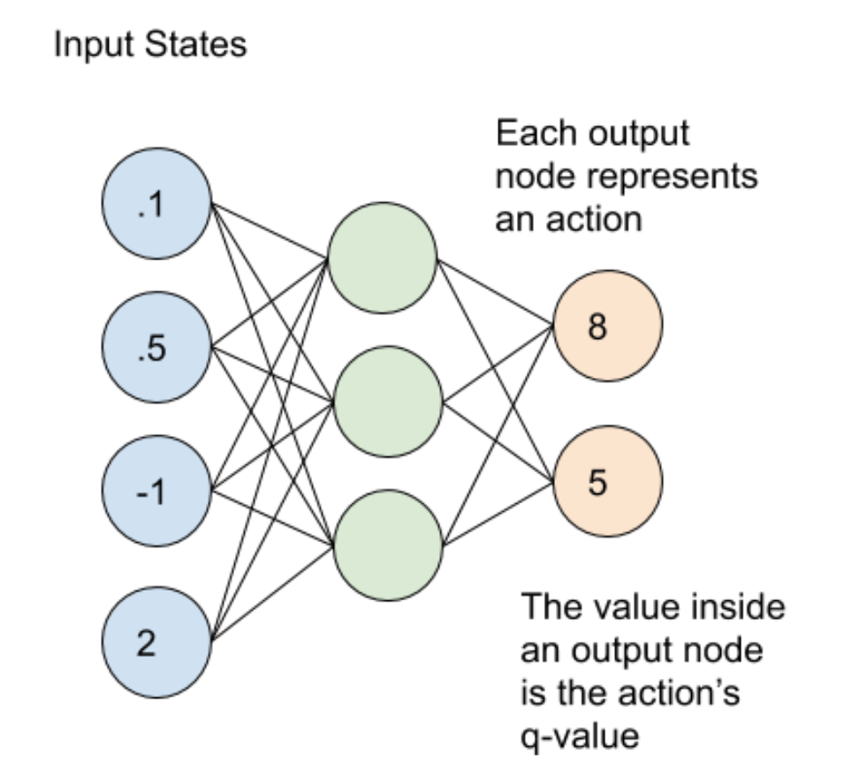
DQN (1)
The learning process uses 2 neural networks. These networks have the same architecture but different weights. Every N steps, the weights from the main network are copied to the target network. Using both of these networks leads to more stability in the learning process and helps the algorithm to learn more effectively. In our implementation, the main network weights replace the target network weights every 100 steps.
The main and target neural networks map input states to an (action, q-value) pair. In this case, each output node (representing an action) contains the action’s q-value as a floating point number. Note that the output nodes do not represent a probability distribution so they will not add up to 1. For the example above, one action has a Q-value of 8 and the other action has a Q-value of 5.

Slide 31
DQN implementation ideas

Slide 32
Video demo

